Slide 1

Group3 LocalNet Squad
Scrum Master Xiaoyu Zhou 1565763 kilizxy@gmail.com
Product Owner jiqiang wang 1564710 robin.nz420@gmail.com
Team Members liang yue 1573011 liangyuemoon666@gmail.com
Xiupeng Cui 1566716 123kobebrant@gmail.com

Slide 2
Problem Currently people use map service for individual purposes, but it is always a challenge of coordinating with a large group of people in a crowded location, such as a music festival or sporting event. Vision statement For a group of users Who want to know each other’s location The magical location Is a mobile map service That people can create or join in a group and share their position with team members. Unlike the normal map service that only supports one user. This could be particularly useful during long road trips or when traveling to unfamiliar destinations, as it can enable users to easily share their location within the group and ensure that no one gets lost or left behind.
- Magical location

Slide 3
Key Features
Distance limitation：5km
User Registration: Allow users to create an account and provide basic information such as name, email, and password
Team authority；Users can create team and automatically became team leader; team leader has the authority to add member in and remove them or transfer the team leader
Start and end the location share services：Allow users apply to joint a team, start to share location and end in anytime
Privacy statement：User must agree to the Privacy statement before they can use the service

Slide 11
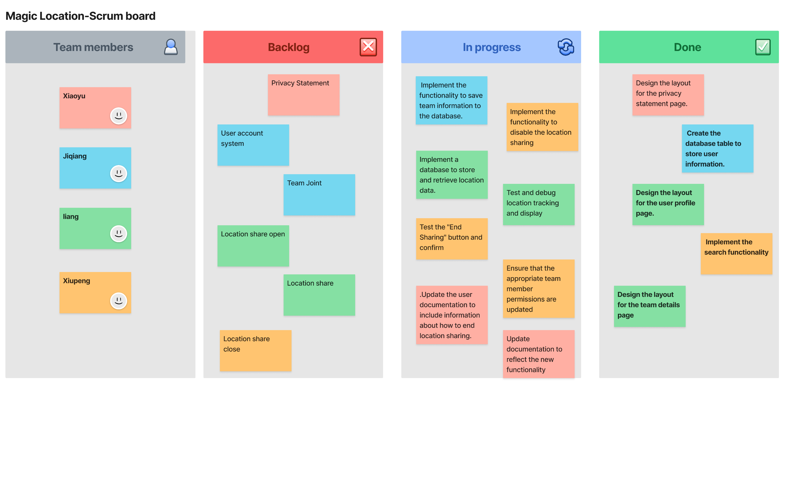

Slide 12
Burn Down Chart

Slide 13
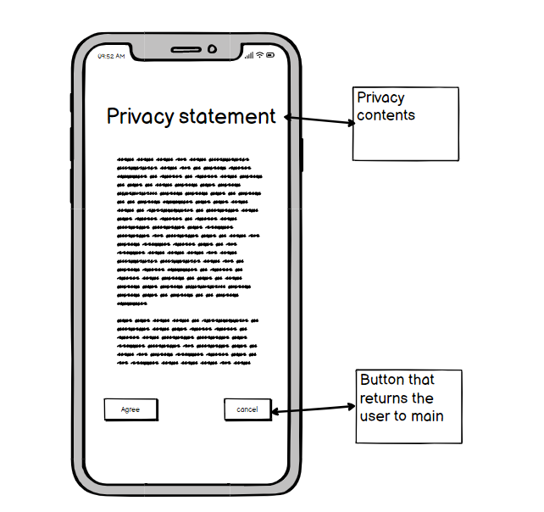
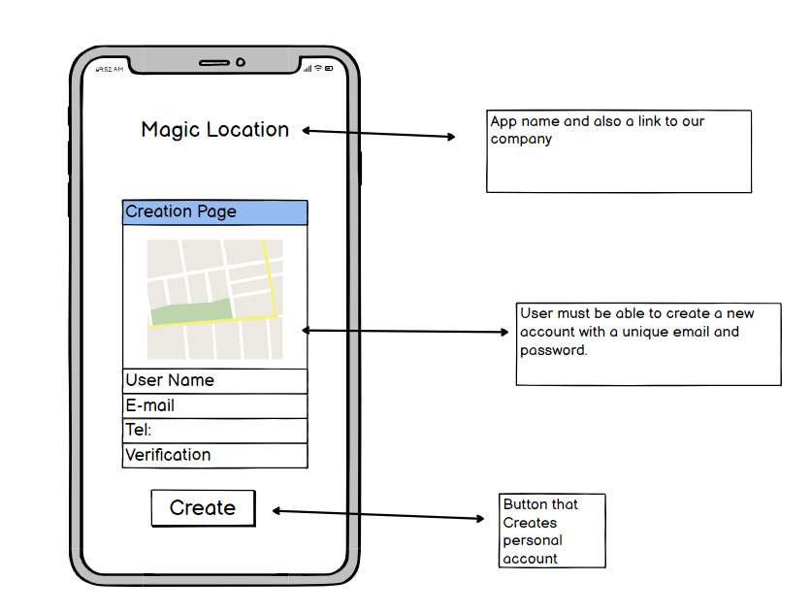

Slide 14
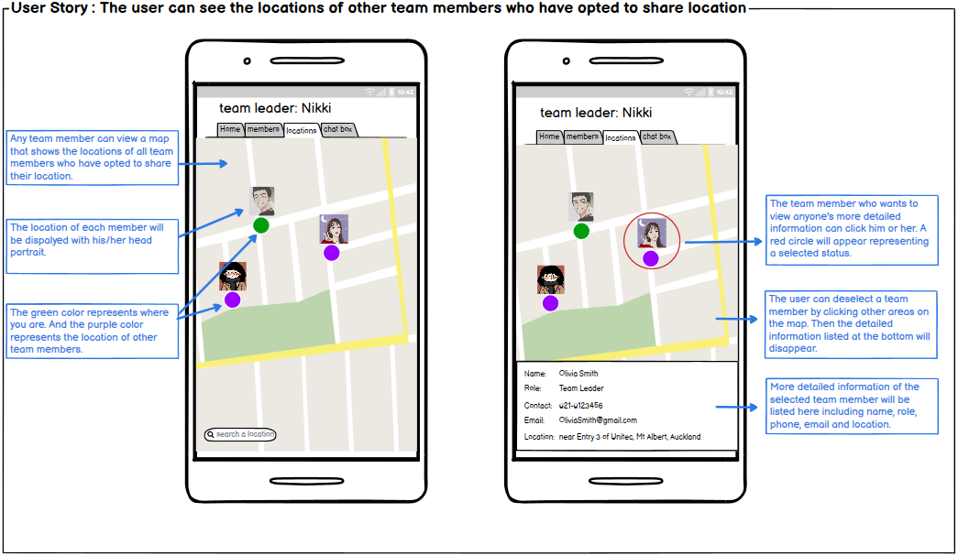

Slide 15
